Slide 1
CREATE PROJECT
by Mykola Sotula

Slide 2
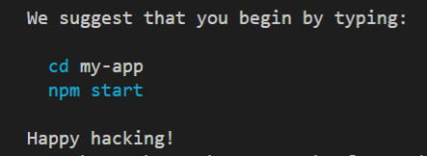
CREATE-REACT-APP
Create default app.
Type in PowerShell or other command line:
create-react-app add Babel and Webpack with instruments.
You will see:

Slide 3

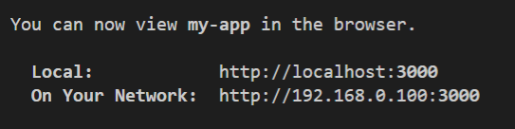
START
Change directory with:
and start with:

Slide 4
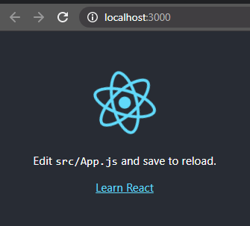
FIRST APP
You will see this in browser.
Congratulations, it is your first React application ^_^

Slide 5
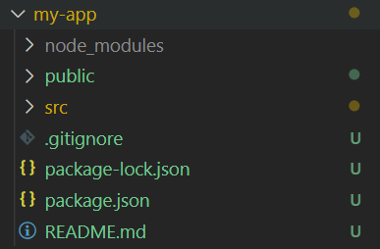
FIRST APP
This is directory structure of your project.
Let's start removing garbage.

Slide 6

ROOT
You can edit the README.md however you like.
I'll leave code like this there

Slide 7

SRC
The src directory contains the application source code
Delete all files except index.js
Remove extra lines to make it look like the image

Slide 8

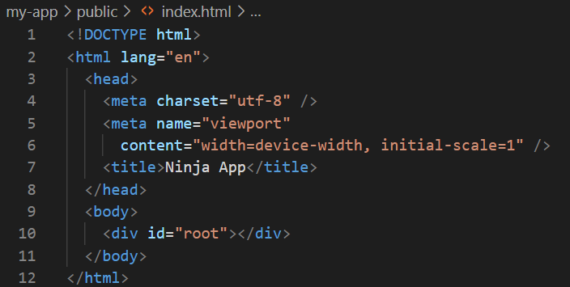
PUBLIC
The public directory contains static code for the browser
Delete all files except index.html
Remove extra lines to make it look like the image

Slide 9
SECOND APP
This is your second app.
In the console, but everyone started with it

Slide 10


